Slide 1


Don’t talk to strangers
Test isolation with containers
Hristo Iliev, Georgi Sabev | SAP Labs
18-19 November, Sofia

Slide 2
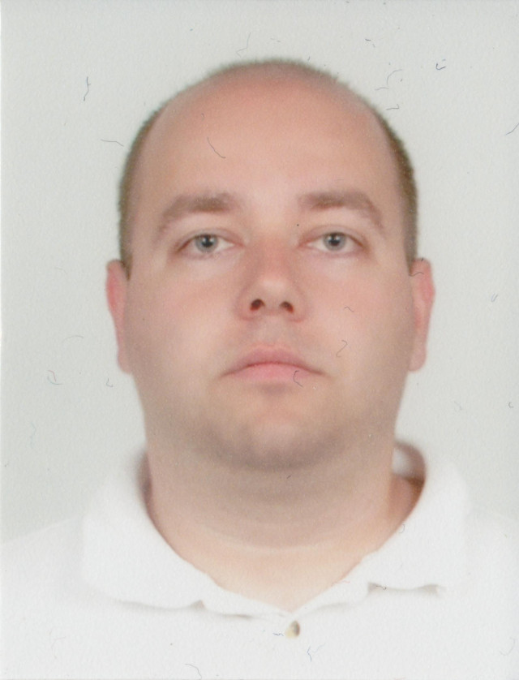
Hristo Iliev
SAP
NetWeaver Java Sever
SAP HANA Cloud Platform
Open Source
Eclipse Virgo
Cloud Foundry (Diego & Abacus)
ISTAcon.org
18-19 November, Sofia
Notes:
In order to build quality software we need:
Tests so that we know it works as expected
Automation that allows us to develop and experiment in a cheap and quick manner -> improve
Tools can help alot
Discipline is required to keep all that is good and improve further

Slide 3
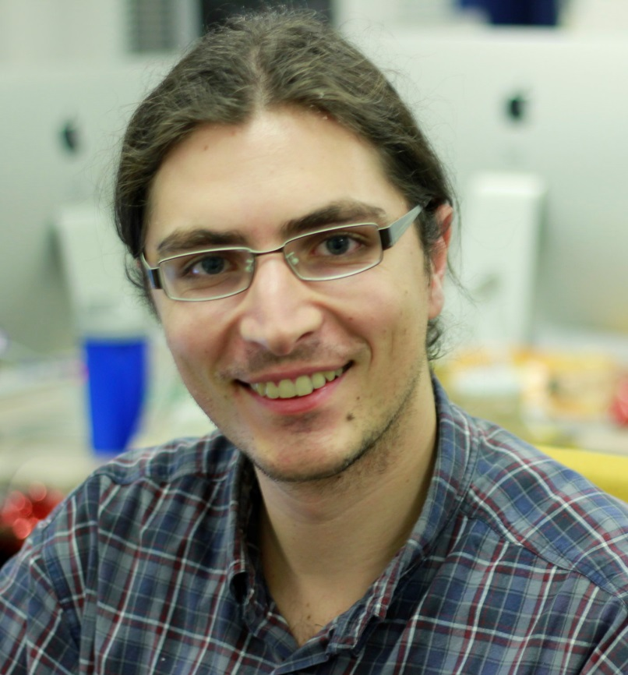
Georgi Sabev
SAP
SAP HANA Cloud Platform
Open Source
Cloud Foundry (Diego & Abacus)
ISTAcon.org
18-19 November, Sofia
Notes:
In order to build quality software we need:
Tests so that we know it works as expected
Automation that allows us to develop and experiment in a cheap and quick manner -> improve
Tools can help alot
Discipline is required to keep all that is good and improve further

Slide 4
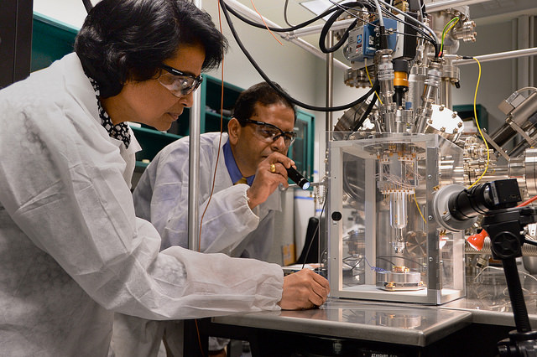
Creating Working Software
Tests
Automation
Discipline
ISTAcon.org
18-19 November, Sofia
Notes:
In order to build quality software we need:
Tests so that we know it works as expected
Automation that allows us to develop and experiment in a cheap and quick manner -> improve
Tools can help a lot
Discipline is required to keep all that is good and improve further

Slide 5
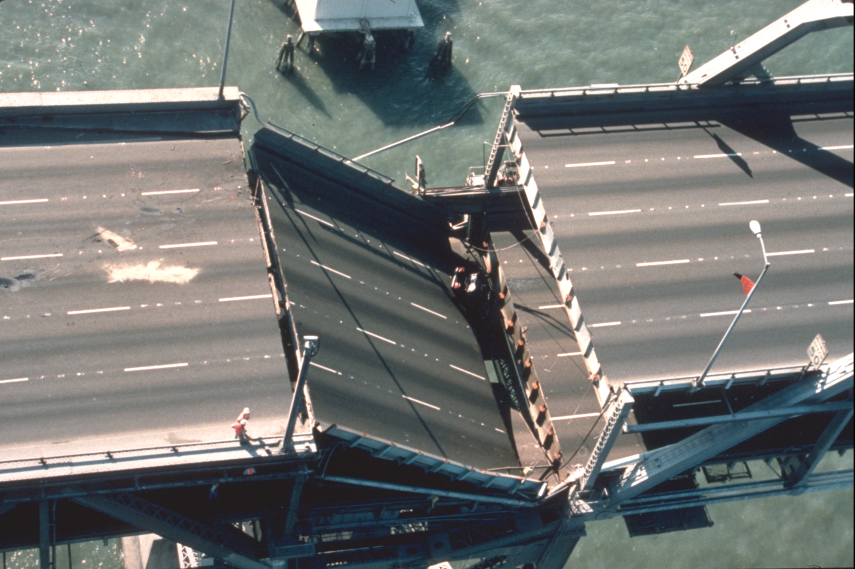
Problems
ISTAcon.org
18-19 November, Sofia
Notes:
Everyone want to build quality systems
Turns out difficult
Following are examples of common pitfalls during testing
We will introduce tools that mitigate the presented problems

Slide 6
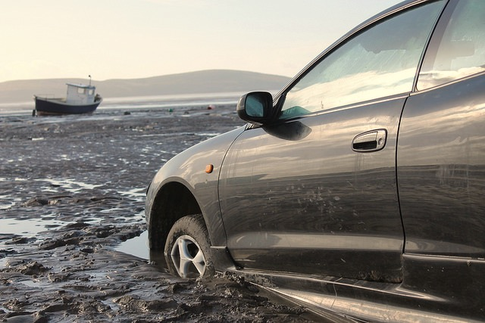
Test pollution
ISTAcon.org
18-19 November, Sofia
Notes:
The first problem we want to present is the test pollution
Let’s see what are the most common reasons to have a polluted environment.

Slide 7

Resources left behind
Environment variables
Database records
Files
Programs / libraries
ISTAcon.org
18-19 November, Sofia
Notes:
In general pollution is caused by resources left behind (as in real life).
These can be
env. Variables
database/storage/persistence data causing an app/program to appear in certain state
files (another form of state)
dependencies already present on the machine

Slide 8


Popular solutions
Workspace Folders
Cleanup Scripts
Discipline
ISTAcon.org
18-19 November, Sofia
Notes:
Workspace Folders in Jenkins and other CI solutions
Clean up scripts (inline bash) in Jenkins
Discipline – always cleaning up resources we no longer need

Slide 9
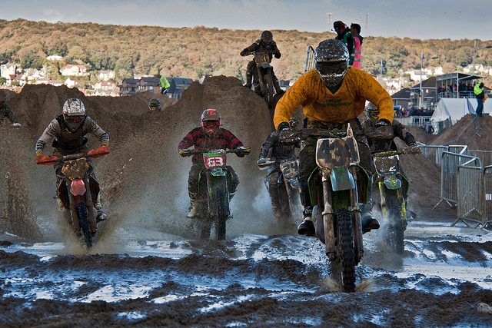
Resource contention CPU & Memory
ISTAcon.org
18-19 November, Sofia
Notes:
Consuming too much cpu/memory causes other leads to starvation for other processes

Slide 10
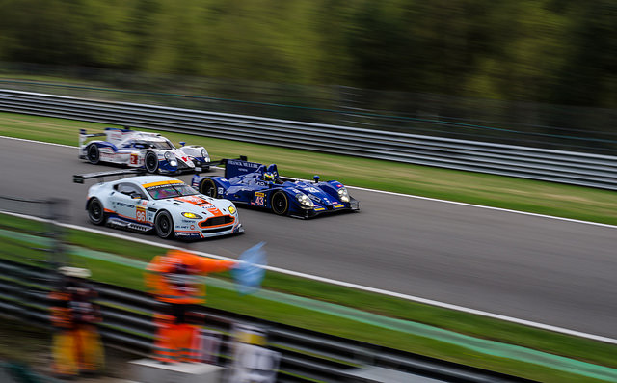
Resource contention
Processes compete for
CPU
Memory
I/O
ISTAcon.org
18-19 November, Sofia
Notes:
Running tests on the same machine may lead to delays and failures (hard to debug)
Not talking for performance but for functional - unit/integration tests

Slide 11
Popular solutions
Physical Separation
Virtual Machines
ISTAcon.org
18-19 November, Sofia
Notes:
Virtual machines can help to separate tests
VMs also leads us to the next problem with tests …

Slide 12
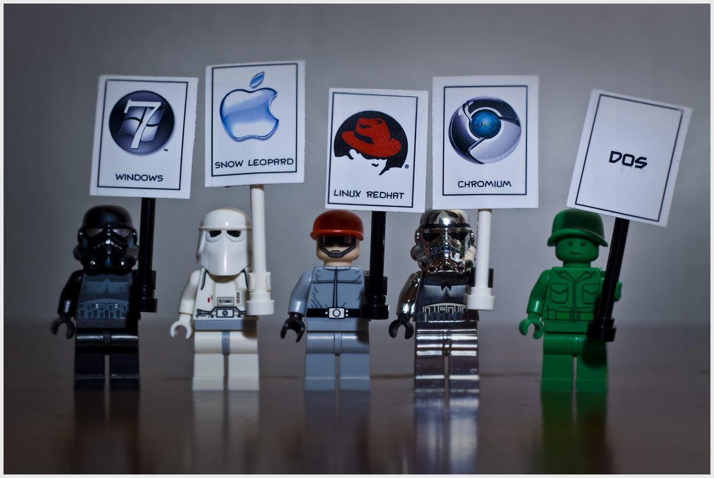
Multiple environments
ISTAcon.org
18-19 November, Sofia
Notes:
Not only different Oses, but also …

Slide 13
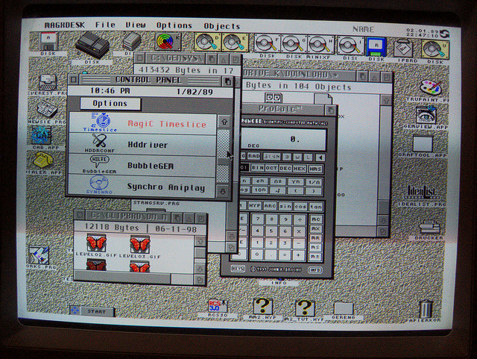
Multiple environments
OS
Mobile / Desktop
Cloud / Standalone
Databases
Versions
ISTAcon.org
18-19 November, Sofia
Notes:
Different
Kind of devices (emulators and physical hardware)
landscapes (cloud)
Backends
Libraries / set of dependencies and programs
Let’s see how we can solve this …

Slide 14
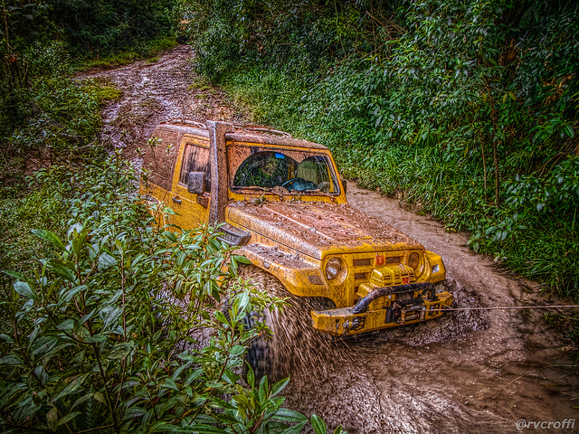
Test problems summary
Test pollution
Resource contention
Multiple environments
ISTAcon.org
18-19 November, Sofia
Notes:
Let’s see how all these problems can be addressed …

Slide 15

Solutions
Traditional
Dedicated hardware
Virtual machines
Cloud: AWS, Azure
New tools
ISTAcon.org
18-19 November, Sofia
Notes:
Dedicated hardware for Android
OS env: AWS (mostly linux), Azure (mostly Windows)

Slide 16
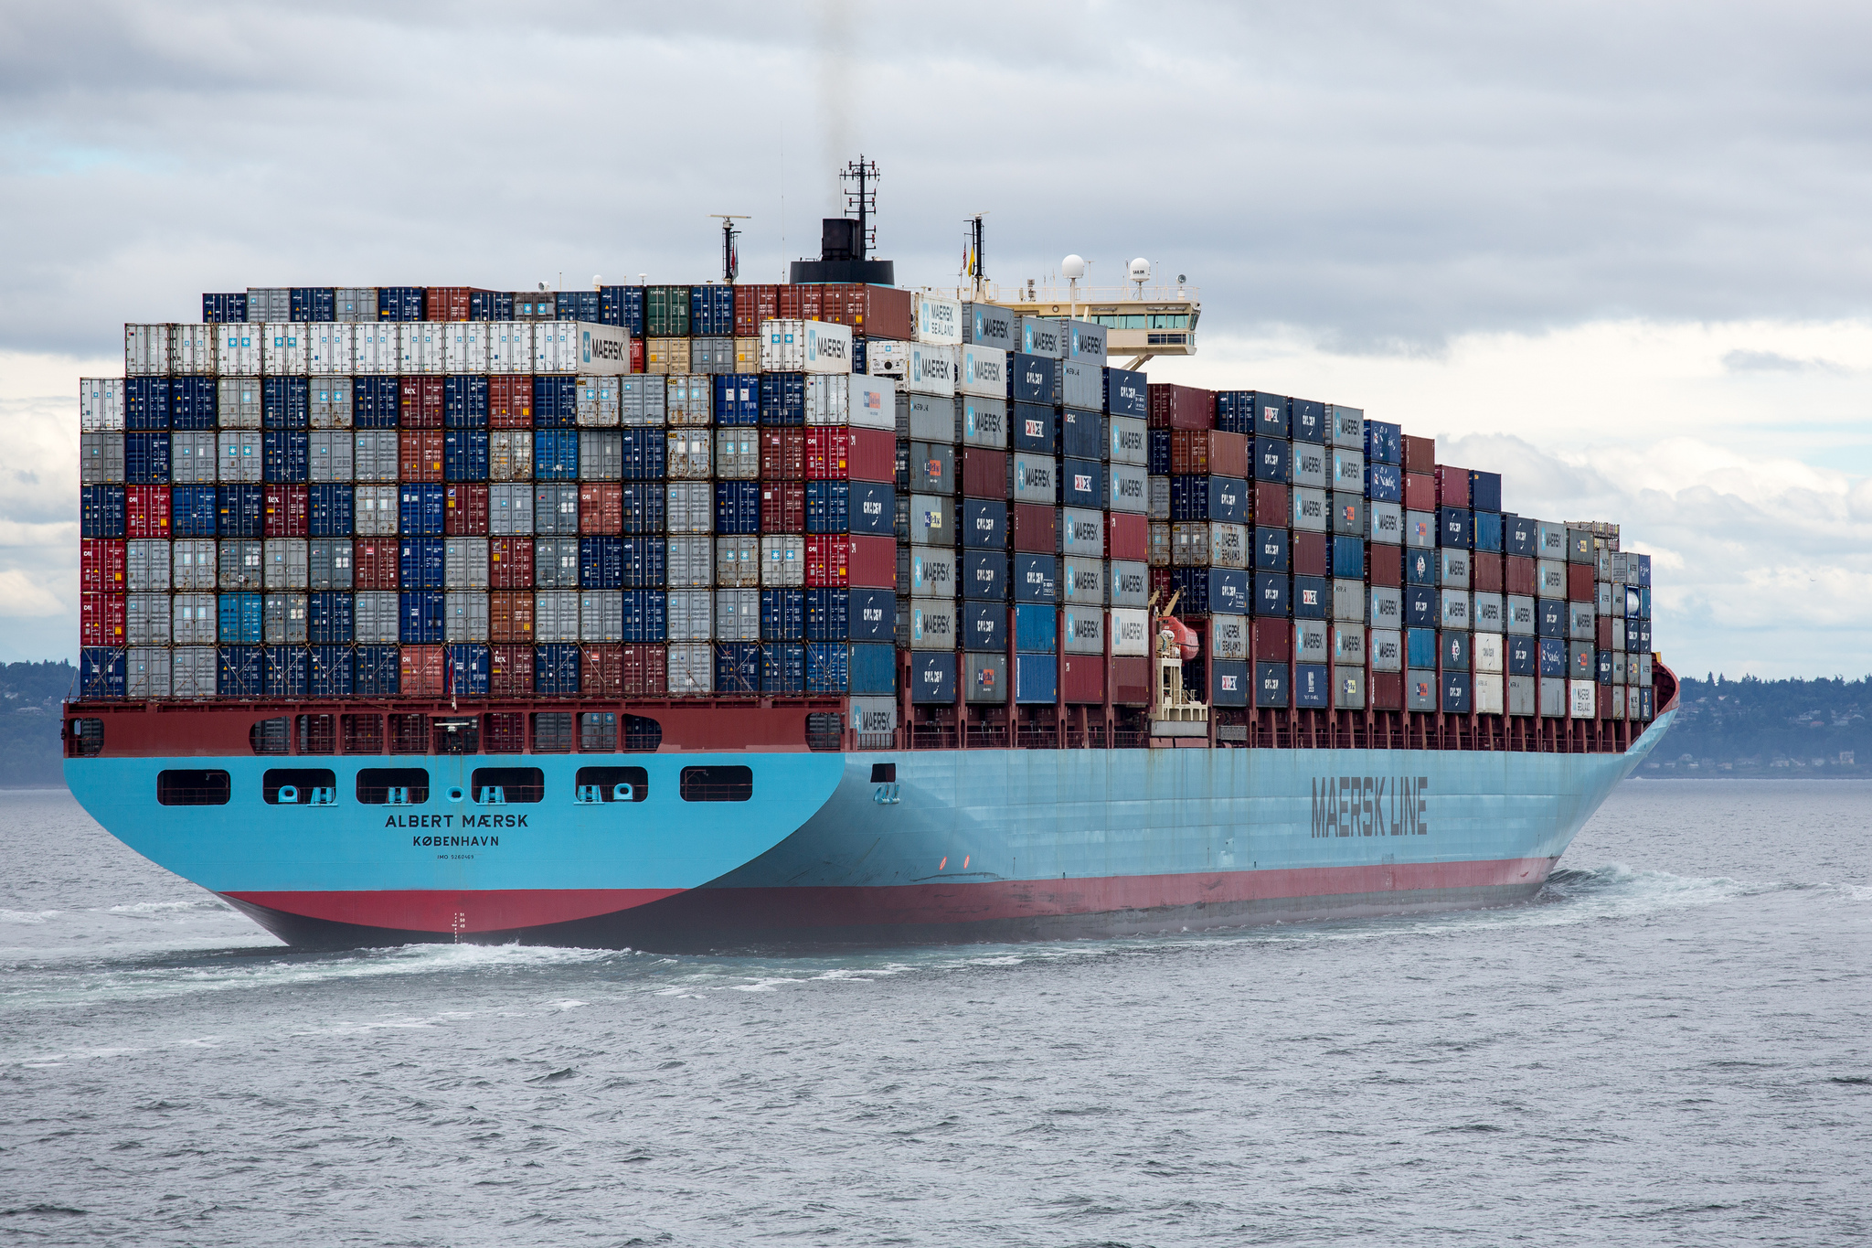
Containers build, isolate, ship
ISTAcon.org
18-19 November, Sofia

Slide 17
Containerization = Lightweight Virtualization
Virtual Machine
Virtual Machine
App
App
App
App
Container
Container
App
App
App
App
Bins / libs
Bins / libs
Operating System
Operating System
Bins / libs
Bins / libs
Hypervisor
Operating System
Hardware
Hardware
Virtualization
Containerization
ISTAcon.org
18-19 November, Sofia
Notes:
Virtualization emulates all devices (memory, disk, video, ….). We can run different OS-es
Containerization allows us to run only a single OS, but is much cheaper and lightweight.

Slide 18
Container: Resource isolation
Shared resources
Kernel
Process A
Process E
Process B
Process C
Process D
Process F
Tenant 1
Tenant 2
Tenant 3
ISTAcon.org
18-19 November, Sofia

Slide 19
Container: Resource isolation
A
B
C
D
E
F
Kernel
Process A
Process E
Process B
Process C
Process D
Process F
Tenant 1
Tenant 2
Tenant 3
ISTAcon.org
18-19 November, Sofia

Slide 20
Container: Resource isolation
CPU
A
B
C
D
E
F
Kernel
Linux Kernel
Process A
Process E
Process B
Process C
Process D
Process F
Tenant 1
Tenant 2
Tenant 3
ISTAcon.org
18-19 November, Sofia

Slide 21
Container: Namespace isolation
Process ID
A
B
C
D
E
F
Kernel
Process A
Process E
Process B
Process C
Process D
Process F
Tenant 1
Tenant 2
Tenant 3
ISTAcon.org
18-19 November, Sofia

Slide 22
Container: Namespace isolation
Process ID
A
B
C
D
E
F
Kernel
Process A
Process E
Process B
Process C
Process D
Process F
Tenant 1
Tenant 2
Tenant 3
ISTAcon.org
18-19 November, Sofia

Slide 23
Container: Namespace isolation
Process ID
A
B
C
A
A
B
Kernel
Same PID
Process A
Process A
Process B
Process C
Process A
Process B
Tenant 1
Tenant 2
Tenant 3
ISTAcon.org
18-19 November, Sofia

Slide 24
Container: Namespace isolation
PID,Network,Mount,User
Kernel
Process A
Process B
Process C
Process A
Process A
Process B
Tenant 1
Tenant 2
Tenant 3
ISTAcon.org
18-19 November, Sofia

Slide 25

Container
Network
PID
?
=
+
+
cgroups
User
Isolation
Content
Processes
ISTAcon.org
18-19 November, Sofia

Slide 26
Container
Network
PID
cgroups
User
ISTAcon.org
18-19 November, Sofia

Slide 27
Container actions
Make me a container
Put this in it
Run this for me
ISTAcon.org
18-19 November, Sofia

Slide 28
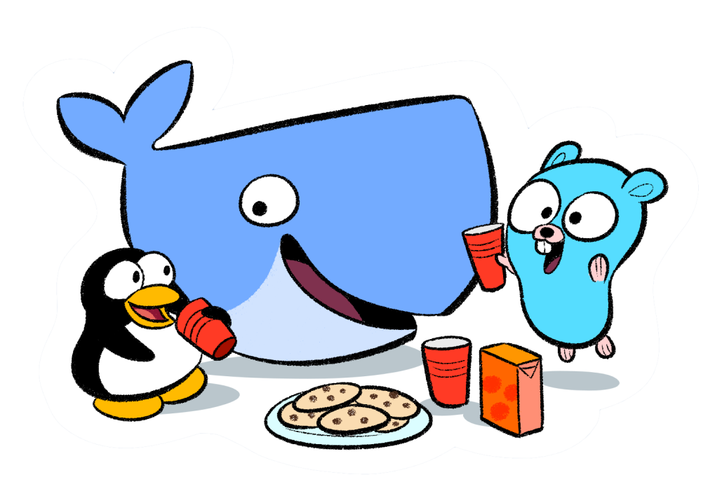
Docker
“Build, Ship, Run” Containers
Dockerfile
Docker image
Docker Hub
ISTAcon.org
18-19 November, Sofia
Notes:
Docker is an implementation of the container idea
Provides definition of container in “Dockerfile”
The container is stored as image
The image is stored on a site/repo - Hub

Slide 29
Dockerfile
Make me a container
Put this in it
Run this for me
ISTAcon.org
18-19 November, Sofia

Slide 30
Dockerfile
Example:
FROM debian:stable
RUN apt-get update && apt-get install -y --force-yes apache2
EXPOSE 80 443
VOLUME ["/var/www", "/var/log/apache2", "/etc/apache2"]
ENTRYPOINT ["/usr/sbin/apache2ctl", "-D", "FOREGROUND"]
ISTAcon.org
18-19 November, Sofia

Slide 31
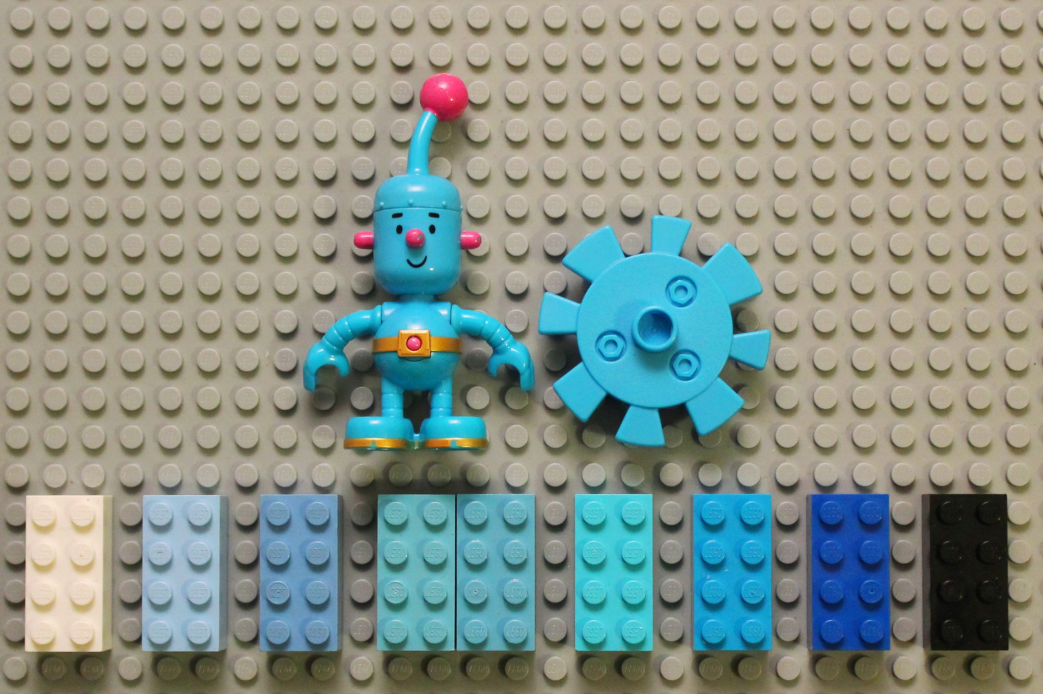
Demo
ISTAcon.org
18-19 November, Sofia

Slide 32
Containers: Pros & Cons
Pros
Isolation
Reproducible environment
Easy to maintain
Cons
Multi-platform
Discipline
ISTAcon.org
18-19 November, Sofia
Notes:
Linux only. Windows requires different VM
Discipline – cleanup still needed. CPU and memory contention is problem in containers too. This has to be addressed in the same way as with VM/standalone env.

Slide 33
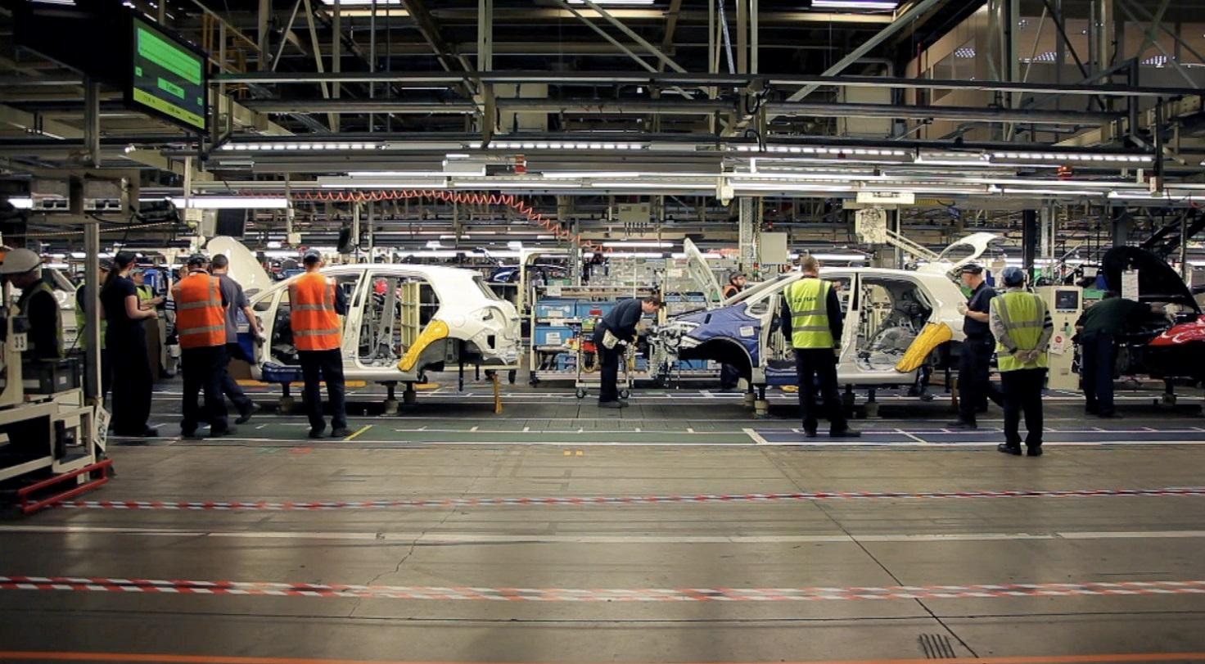
Software Production
Complexity
Tests
Automation
ISTAcon.org
18-19 November, Sofia
Notes:
When producing softwere we have to:
Deal with high complexity
Have an ‘assembly line’ like process for testing
Have this automated

Slide 34

Pipelines Multiple-builds
ISTAcon.org
18-19 November, Sofia
Notes:
Pipelines can help us reach from build through testing to the final packaging and release of our product

Slide 35
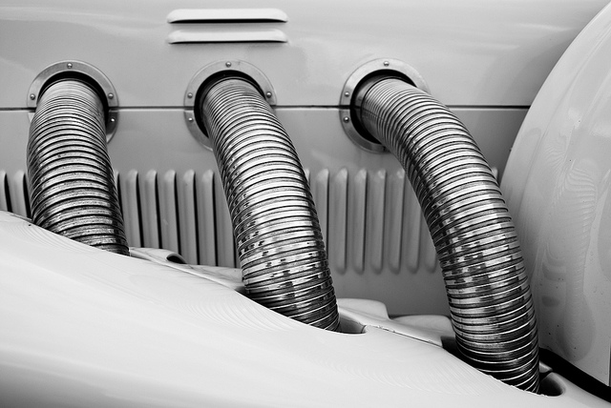
Continuous Integration & Delivery
Multiple
Environments
Products
Teams
Final release
ISTAcon.org
18-19 November, Sofia
Notes:
We need to use different environments
Different product often share a common source base
A lot of teams collaborate on a product
Finally we build and ship a release as a result of all the tests/builds

Slide 36
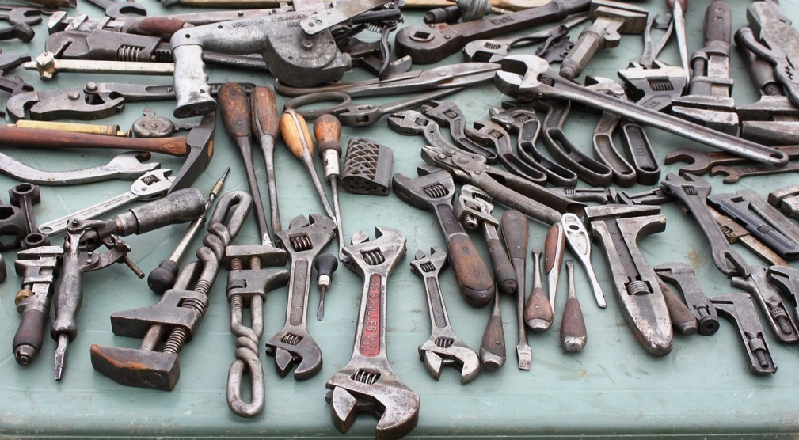
Containers to the rescue
Build
Test
Unit
Integration
Release
ISTAcon.org
18-19 November, Sofia
Notes:
We can do everyting in a container
However we are missing one important concept …

Slide 37
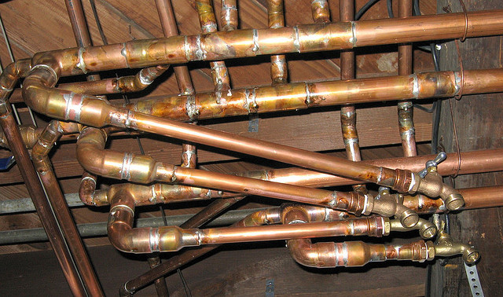
Popular solutions
Build servers
Jenkins
Travis
…
Homegrown
ISTAcon.org
18-19 November, Sofia
Notes:
We can use popular solutions with containers
Or use homegrown tools
However … they all miss the concept of a pipeline and don’t treat it as a first class citizen
That’s why ...

Slide 38
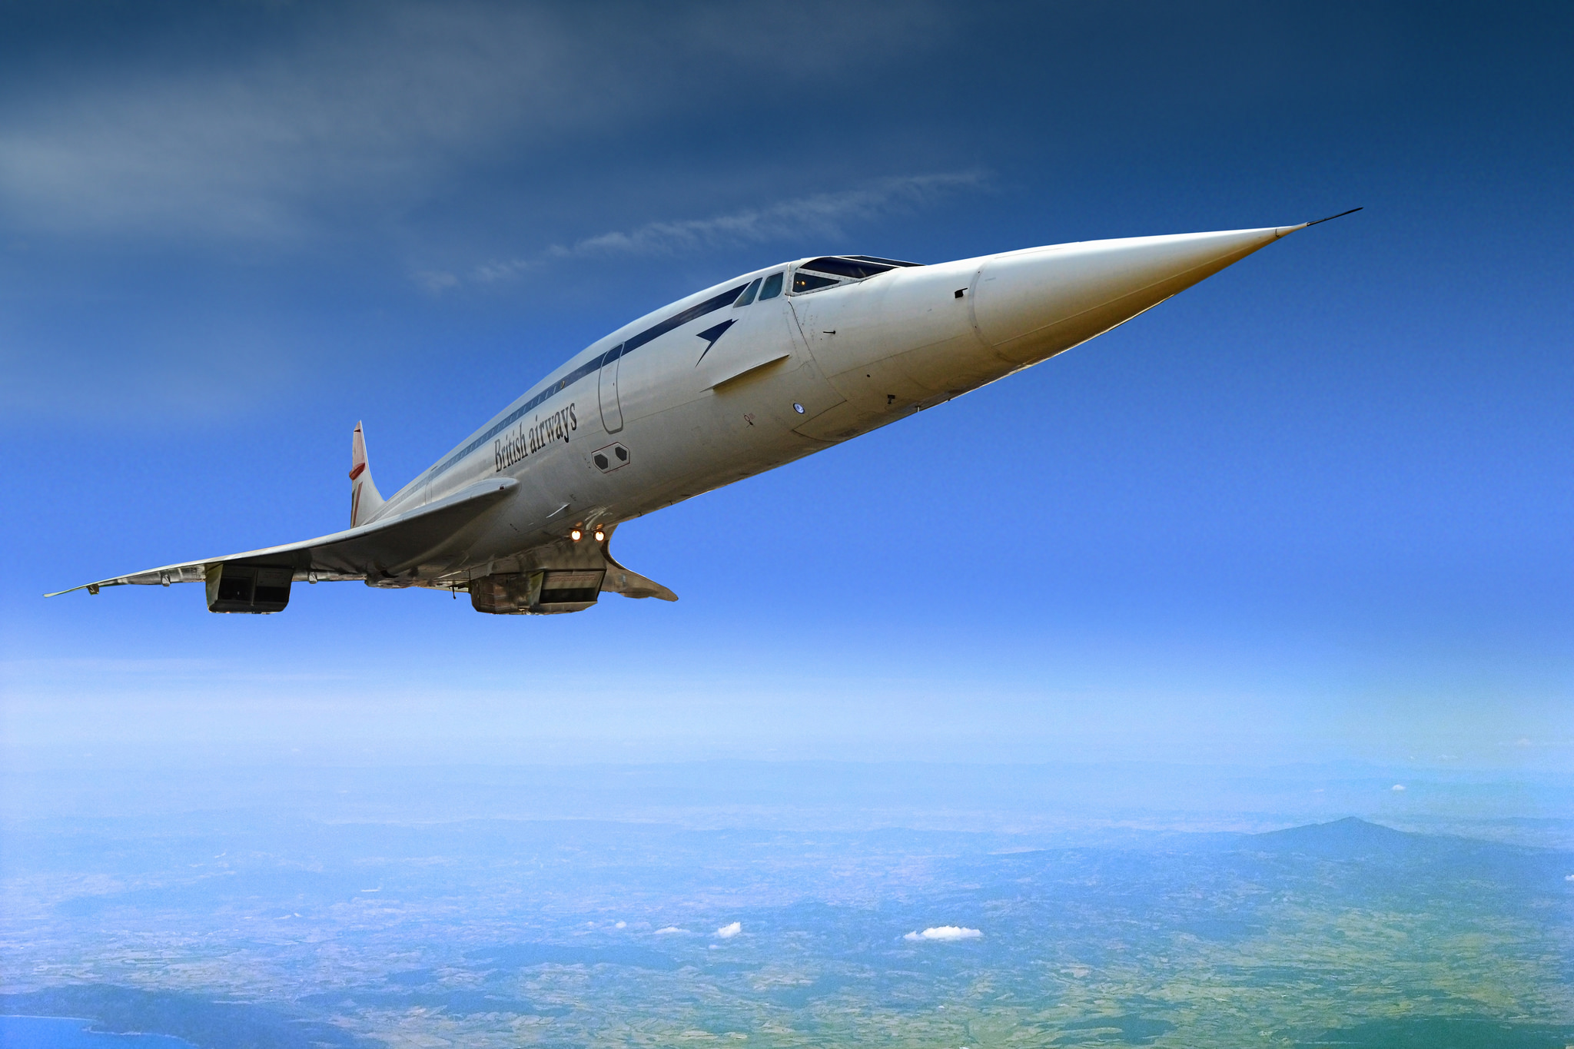
Concourse CI, Pipelines, Delivery
ISTAcon.org
18-19 November, Sofia
Notes:
CI that understands pipelines

Slide 39
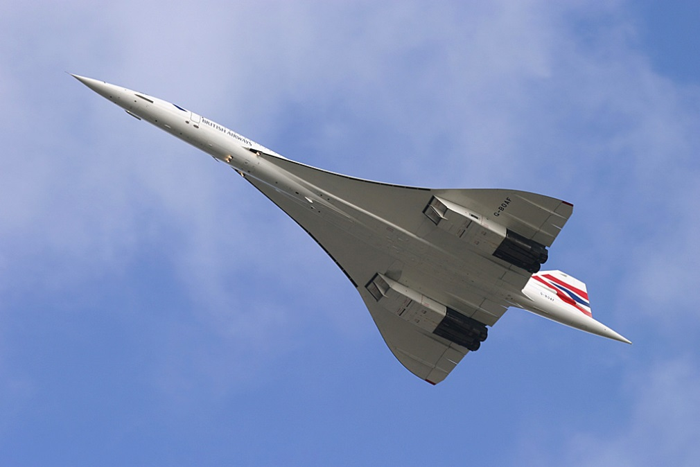
Concourse
CI
Reproducible builds
Simple building blocks
Docker containers
ISTAcon.org
18-19 November, Sofia

Slide 40
Concourse: Concepts
Resources
Tasks
Jobs
Build Job
Configure
Make
Install
Source
Binary
ISTAcon.org
18-19 November, Sofia

Slide 41
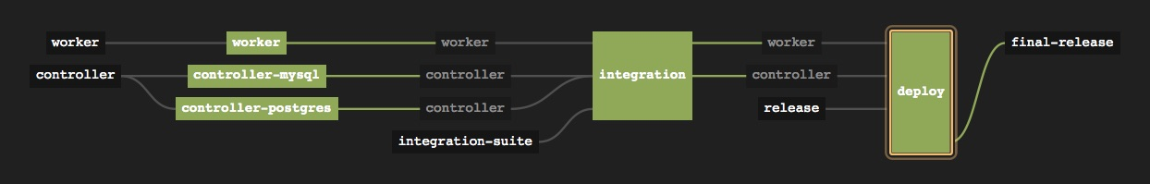
Concourse: Pipeline
validated resource
job
resource
ISTAcon.org
18-19 November, Sofia
Notes:
Conveyor that accepts resources on the input and after processing/manifacturing outputs releases on the output.
Resources:
Worker
Controller
Integration suite
Release
Final-release
Jobs:
Worker build & unit test
Controller build & mysql test
Controller build & postgres test
Integration test
Deploy

Slide 42
Concourse: Pipeline YML
resources:
- name: source
type: git
source:
uri: source.git
branch: master
jobs:
- name: build
plan:
- get: source
- task: build
file: build.yml
ISTAcon.org
18-19 November, Sofia

Slide 43
Demo
ISTAcon.org
18-19 November, Sofia

Slide 44
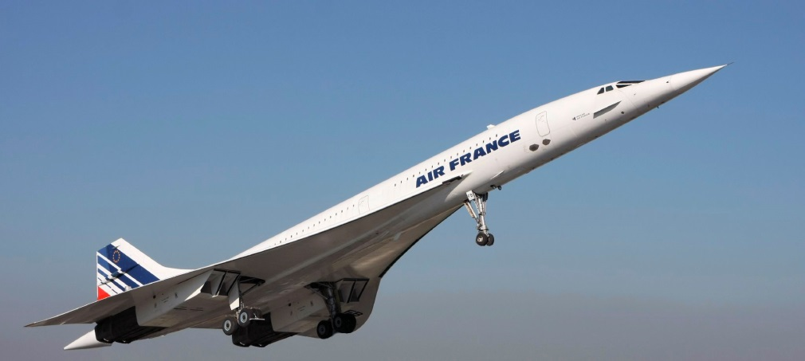
Concourse: Pros & Cons
Pros
Reproducible environment
Native pipeline support
Release process modeling
Cons
Maturity
Pipeline management
Scripting
ISTAcon.org
18-19 November, Sofia
Notes:
Pros
Reproducible environment – configuration in pipeline.yml
Native pipeline support – pipeline = resources + tasks & jobs
Release process modeling – easy to model the whole (end to end) release process
Cons
Maturity – not matury. A lot of changes
Pipeline management – build & support of pipelines is hard
Scripting – a lot of scripting involved in tasks/jobs

Slide 45

Integer tincidunt libero a ex venenatis cursus. Vivamus accumsan congue tristique.
Up to
Six bullets
For best results
Up to
Six bullets
For best results
ISTAcon.org
18-19 November, Sofia

Slide 46

Integer tincidunt libero a ex venenatis cursus. Vivamus accumsan congue tristique.
Up to
Six bullets
For best results
Up to
Six bullets
For best results
ISTAcon.org
18-19 November, Sofia

Slide 47
Major point without a picture
And its subtitle
ISTAcon.org
18-19 November, Sofia

Slide 48
Integer tincidunt libero a ex venenatis cursus. Vivamus accumsan congue tristique.
Up to
Six bullets
For best results
Up to
Six bullets
For best results
ISTAcon.org
18-19 November, Sofia

Slide 49
Integer tincidunt libero a ex venenatis cursus. Vivamus accumsan congue tristique.
Up to
Six bullets
For best results
Up to
Six bullets
For best results
ISTAcon.org
18-19 November, Sofia

Slide 50

Integer tincidunt libero a ex venenatis cursus. Vivamus accumsan congue tristique.
ISTAcon.org
18-19 November, Sofia

Slide 51
Integer tincidunt libero a ex venenatis cursus. Vivamus accumsan congue tristique.
ISTAcon.org
18-19 November, Sofia

Slide 52









Some icons for use throughout the presentation
ISTAcon.org
18-19 November, Sofia

Slide 53

Thank you!
hristo.iliev@sap.com
georgi.sabev@sap.com
Hristo Iliev, Georgi Sabev | SAP Labs
18-19 November, Sofia

